Slide 1
GP Forward View
Doug Middleton
Chief Operating Officer
Solihull CCG

Slide 2
GP Forward View
Overview
Workforce
Workload
Infrastructure
Care Redesign
Local Response

Slide 3
Overview
NHS England published a “General Practice Forward View” in April 2016
The document plan contains specific, practical and funded steps to strengthen workforce, drive efficiencies in workload, modernise infrastructure and technology, and redesign the way modern primary care is offered to patients.
It earmarks an extra £2.4 billion a year for general practice services by 2020/21
Meaning spending will rise from £9.6 billion in 2016/17 to over £12 billion by 2021 - a 14% real terms increase
This investment will be supplemented by a £500 million national 'turnaround' package to support GP practices, and additional funds from local clinical commissioning group

Slide 4
Workforce
Action to double the growth rate in GPs, through new incentives for training, recruitment, retention and return to practice. The aim is to add 5,000 additional GPs in the next five years
There will be 3000 new fully funded practice-based mental health therapists
An extra 1,500 co- funded practice clinical pharmacists
Nationally funded support for practice nurses, physician assistants, practice managers and receptionists.

Slide 5
Workload
The plan sets out a new practice resilience programme to support struggling practices
Changes to streamline the Care Quality Commission inspection regime
Support for GPs suffering from burnout and stress
Cuts in red-tape, legal limits on administrative burdens at the hospital/GP interface
Action to cut inappropriate demand on general practice.

Slide 6
Infrastructure
Upgrades to practice premises
Direct practice investment in technology to support better online tools and appointments, consultation and workload management systems
Better record sharing to support team work across practices
New rules will allow up to 100% reimbursement of premises developments (present cap is 66%).

Slide 7
Care Redesign
The document signals practical support for individual practices and for federations and super-partnerships
There will be direct funding for improved in hours and out of hours access, including clinical hubs and reformed urgent care
A new voluntary GP contract supporting integrated primary and community health services

Slide 8
Local Response
Development of a Primary Care Vision and Transformation Plan
  Engagement recently taken place
  Interviews, Surveys
  GPs, nurses, practice staff and patients
  Overview in next few slides
Specifics
  Premises – 4 proposals made to the Estate and Technology Fund
  Information Technology – 1 borough wide proposal also submitted

Slide 9
Project timeline
Plan
Who
When
Listen
Interviews
Focus groups
Test
How
Surveys
Feedback
June
July
Aug
Sept

Slide 10
Responses and coverage
144 patient responses- survey
113 Practitioner responses- survey plus interviews
Every single practice has contributed at least one response.
  only one practice did not contribute a response from staff
only three did not contribute a response from a patient.
  GP responses:41 responses from partners, 10 responses from locum or salaried GPs.
  Practice nurses: 22, HCAs 2
  Practice managers 15, Receptionists 11
Listening at:
  PLT
  nurses forum
  VTS scheme
  patient panel
  practice managers.

Slide 11
Analysis
Quantitative analysis - closed questions
  Rating from 1=10 where 1 is unimportant and 10 is critical
  Mean and modal averages to indicate spread and consistency
Qualitative analysis - open questions
  What do you like most about your work?
  What would you like to do more of
  What are you most proud of
  What would make it better?

Slide 12
Practice data:
Quantitative responses
Red is Important. Green is unimportant.
Some questions consistently red or green.
Some questions: polarised views.

Slide 13
Patient data: Quantitative
Responses

Slide 14
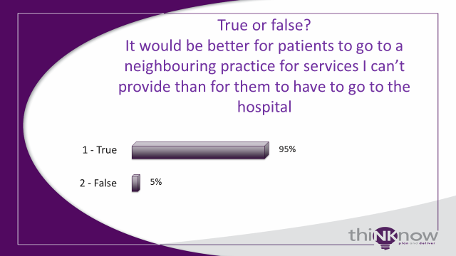
Appetite for practices to collaborate
Patients
Practices

Slide 15
Appetite for extended day/ week

Slide 16
What practices most value about current arrangements

Slide 17
What Practices are most proud of

Slide 18
What Practice staff would like to do more of

Slide 19
We asked staff about improvements for them and for their patients

Slide 20
Emerging themes for the vision
Access | Getting appointments quickly, easily and with the right person, right setting, right length of time.
Continuity/ co-ordination | Balance seeing the same person, developing relationships, co-ordination of long-term care vs delivery of short =term/ immediate fixes. Balance small teams where everyone knows everyone vs the flexibility afforded by larger teams.
Quality (clinical, business and environmental) | Clinical and organisational: Spread of innovation, being as good as the best, learning from each other, sharing expertise, Plus: Buildings / car-parking/ IT
Proactive/ prevention/ | Helping patients to help themselves, working with the wider team, appropriate use of services shaping demand and expectations
Administration and systems | Automation, removing bureaucracy and no-value processes, do once and share, sharing expertise workforce parity issues

Slide 21
Next steps
Testing of emergent themes (July- early Sept)
Draft final report considered by primary care pod 15th sept
Final report shared with primary care commissioning ctte 21st sept
Final report shared with PLT member forum 28th sept
Papers GB meeting published on 28th sept for 5th Oct meeting)

